Slide 1

Pocket Chef

Slide 2
Product Interface and Interface Components
Home Screen:
Add Recipe
View Recipe
Delete Recipe
Search Recipe
Edit Recipe
Add/Edit Recipe:
Save Recipe
Cancel
View Recipe:
Edit Recipe
Delete Recipe
Exit
Delete Recipe:
Confirm
Cancel
Search Recipe:
View Recipe
Exit
View
Recipe
Recipe
View
Edit Recipe
Edit
Recipe View
Delete Recipe
View
Recipe
Exit
Recipe
Edit Recipe
Search Screen
Delete Confirmation
Opening Screen
Save Recipe
or Cancel
Delete
Recipe
Add Recipe
Recipe
Search
Add
Recipe View
Exit Search

Slide 3
Target Execution System
The app is targeted to phones running Android
SDK version 15 (99.1 % of all Android phones)
ARM and x86_64 systems
The recipes will be stored on a local database and need access

Slide 4
Build Process
Sign keys are generated and secured by password
On release Gradle is run to compile the code
The code obfuscation is then done by Proguard
The resources and the code are combined in an APK file and then digitally signed
Our minimal configuration management system is Github

Slide 5
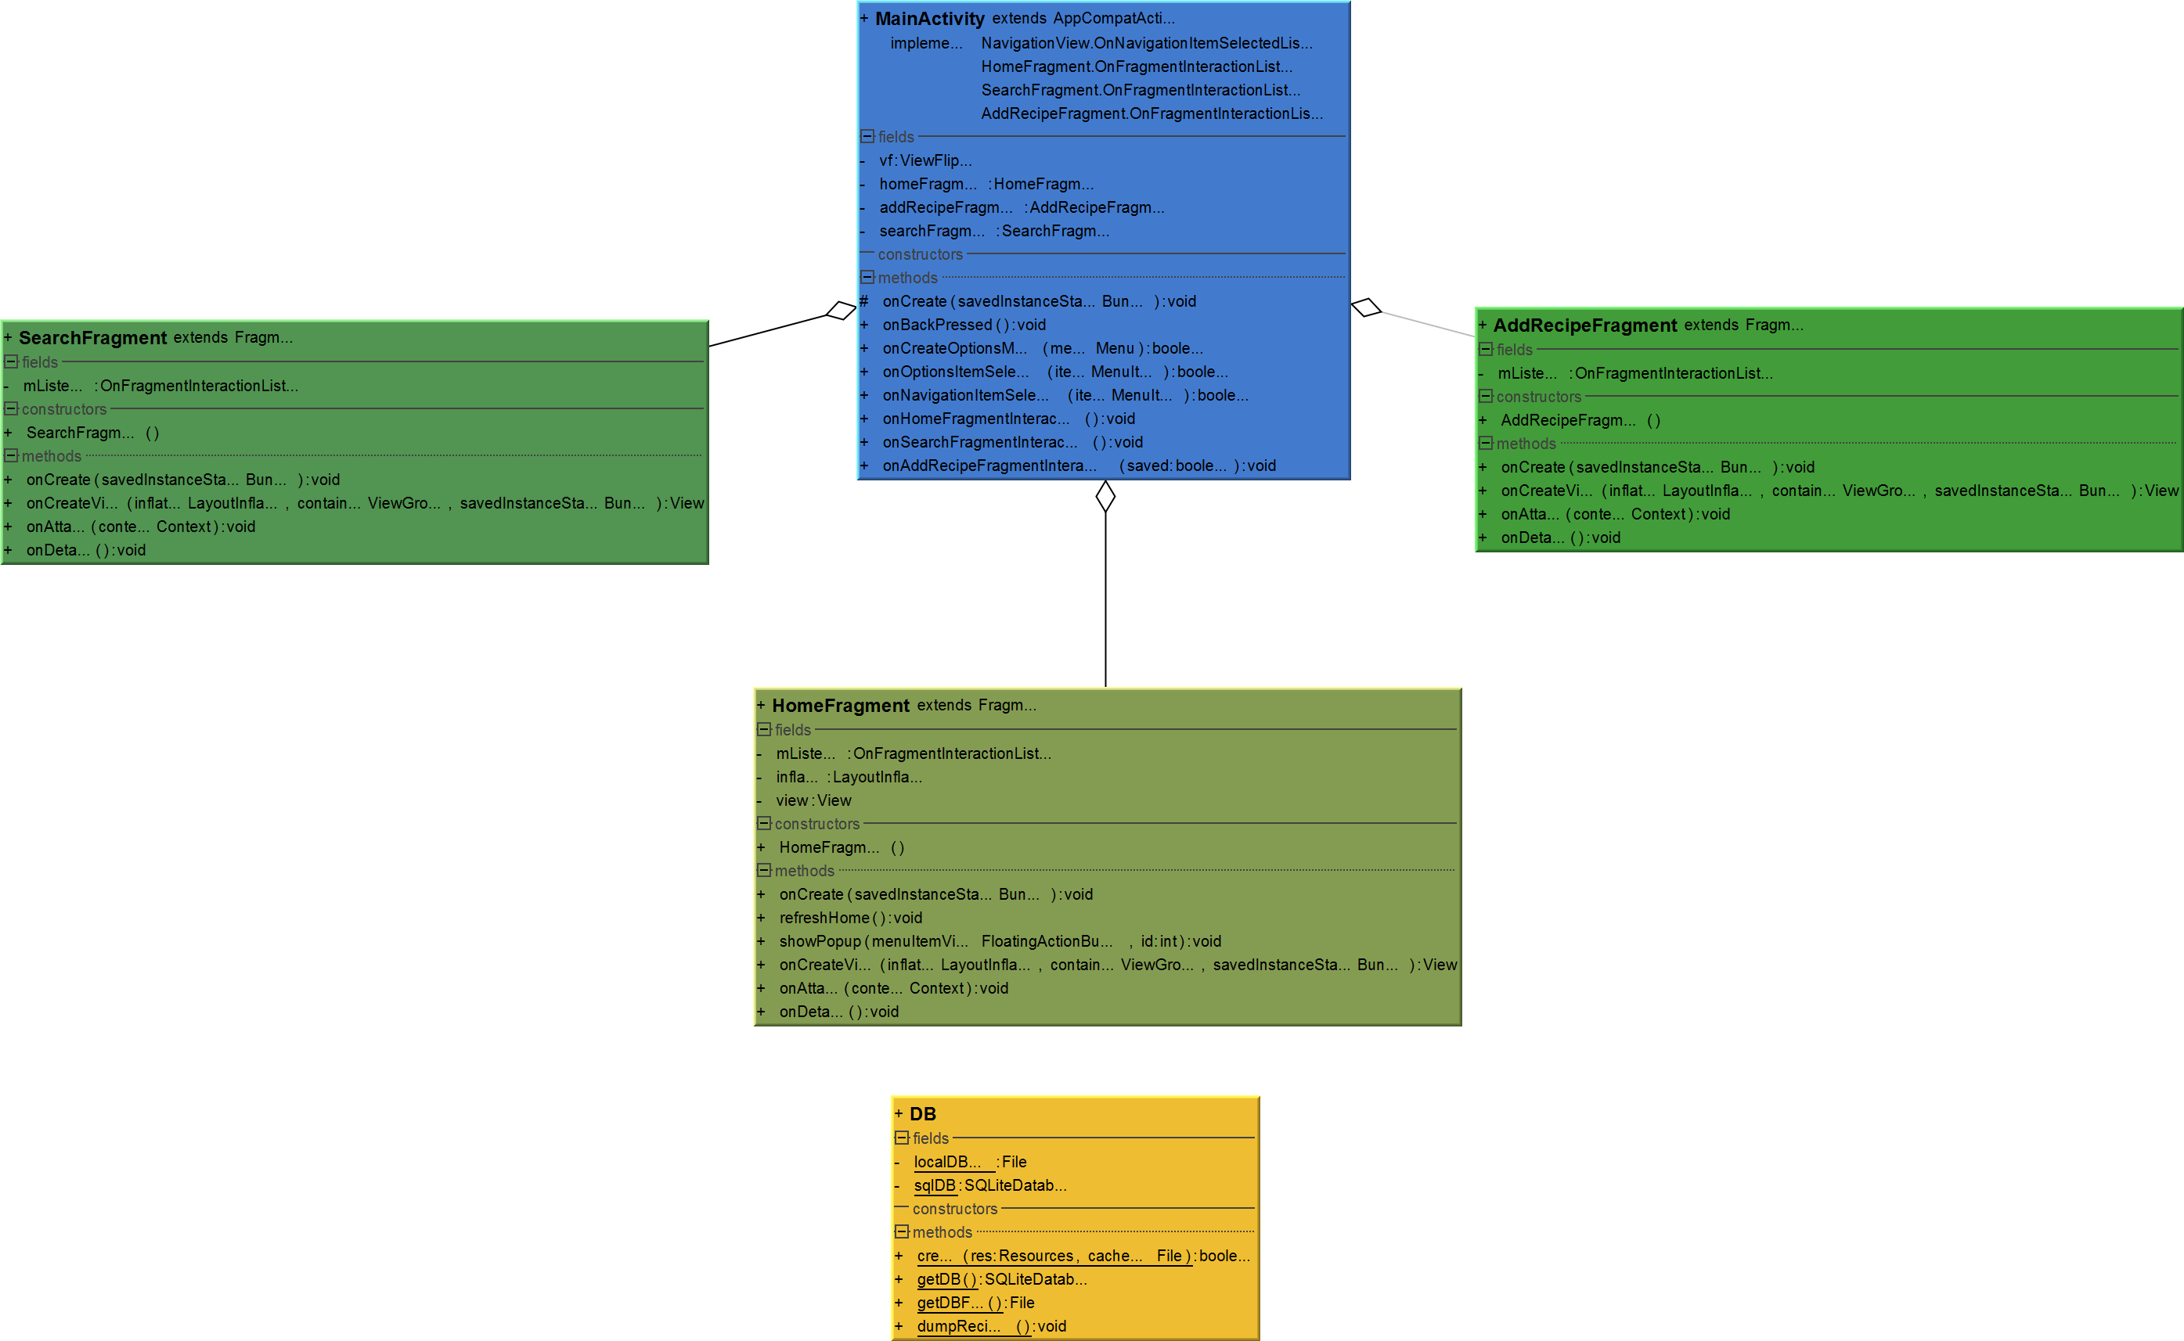

Slide 6

Design of AddRecipeFragment
This is the page the user sees to allow adding recipes
AddRecipeFragment constructor creates the object for use in the user interface
onCreate sets initial variables for later use
onCreateView creates the components and attaches listeners to them
onAttach informs us when the fragment is attached to the Activity

Slide 7
Host Development Platform
This app was developed using Android Studio in the language Java
For testing, Android Phone Emulator in Android Studio was used
2,028 lines of Java
2,000 lines of Layout files (not including duplicate files)
1,000 additional lines of Java are expected

Slide 8
SQLite Subsystem
Using a SQLite studio the database schema was designed to store recipe information
Using libraries and built in functions allow for easy interaction with the local database
Using SQLite allows for the easy storing of information without error
SQLite has allowed us to reduce the implementation time

Slide 9


Software and licensing
Both Android Studio and SQLite are open source, so no issue is expected from licensing
Google play developer console
Android SDK is released under the Apache software license version 2

